Slide 1

September 30, 2019
Jeju National University
Clinical Trial Blockchain (Draft)
Development Results
Notes:
Thank you Mr. Chairman.
I’m Do-Hyeon Kim of Chonan Univ. in Korea.
The topic of my talk, today, is “An Architecture for Mobility Management in Mobile Computing Networks”.
In this paper, we proposed the an efficient architecture for mobility management in mobile computing networks.

Slide 2
Contents
Fabric Network Configuration for Clinical Trial Blockchain
Hyperledger Explorer Configuration for Clinical Trial Blockchain
Clinical Trial Blockchain Testing

Slide 3
Fabric Network Configuration for Clinical Trial Blockchain – Development Environment
Component | Description
OS | Ubuntu Linux 18.04.1 LTS
CPU | Intel Core i5-8500 @ 3.00GHz
Memory | 12GB
Docker-Compose | V1.24.0
Node | V8.11.4
Hyperledger Fabric | V1.4.2
Hyperledger Composer | V0.20.9
IDE | composer-playground
CLI Tool | composer-cli, composer-rest-server
Blockchain Explorer | Hyperledger Explorer (0.3.9)
Test Environment

Slide 4
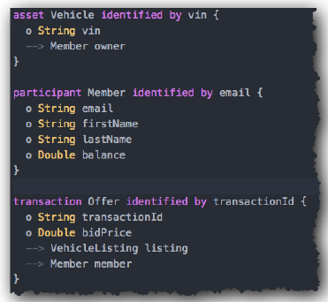
Hyperledger Composer
Blockchain business network modeling toolset
High-level application abstraction suite for blockchain business network
Accelerate time to develop use cases and make it easier to deploy a blockchain solution
Functionalities
Model business networks
Provide APIs to communicate with the business network
Support integration with existing systems thru Loopback / REST

Slide 5
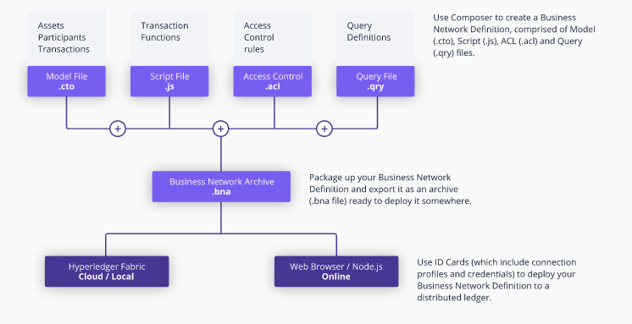
Composer BNA Structure
Composer allows us to package a few different files and generate an archive which can then be deployed onto a Fabric network. To generate this archive, we need:
Model — A definition of the resources present in the network. These resources include Assets, Participants, and Transactions.
Script File— Logic for the transaction functions
Access Control — Contain various rules which define the rights of different participants in the network. This includes, but is not limited to, defining what Assets the Participants can control.
Query File (optional) — A set of queries which can be run on the network. These can be thought of as similar to SQL queries.

Slide 6
Prerequisites 1/2
The following are prerequisites for installing the required development tools:
Operating Systems: Ubuntu Linux 14.04 / 16.04 LTS (both 64-bit), or Mac OS 10.12
Docker Engine: Version 17.03 or higher
Docker-Compose: Version 1.14 or higher
Node: 8.9 or higher (note version 9 and higher is not supported)
npm: v5.x
git: 2.9.x or higher
Python: 2.7.x
A code editor of your choice, we recommend VSCode
If you're running on Ubuntu, you can download the prerequisites using the following commands:
curl -O https://hyperledger.github.io/composer/latest/prereqs-ubuntu.sh
chmod u+x prereqs-ubuntu.sh

Slide 7
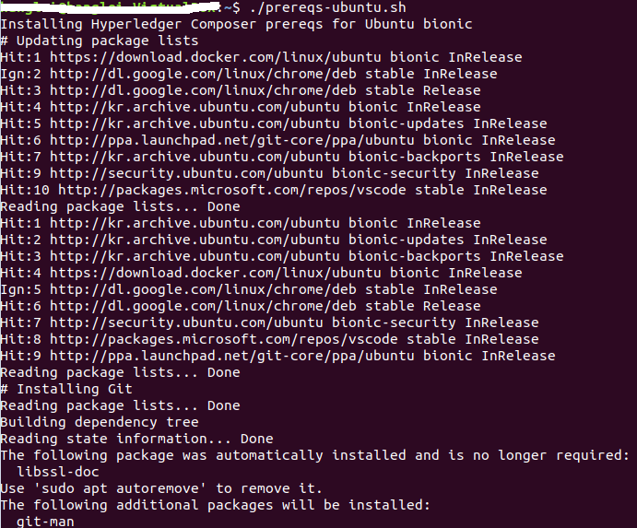
Prerequisites 2/2
Note: Hyperledger Fabric (greater than v1.4) requires the docker-compose version 1.14.0 or greater installed. As shown in the following figure, the version number in the prereqs-ubuntu.sh file is changed to 1.24.0.
Next run the script - as this briefly uses sudo during its execution, you will be prompted for your password.
./prereqs-ubuntu.sh
Prereqs.ubuntu.sh file

Slide 8
Installing the Development Environment 1/2
Install the CLI tools
npm install -g composer-cli@0.20
npm install -g composer-rest-server@0.20
npm install -g generator-hyperledger-composer@0.20
npm install -g yo
Install Playground
npm install -g composer-playground@0.20
Set up IDE
Install VSCode: https://code.visualstudio.com/download
Open VSCode, go to Extensions, then search for and install the Hyperledger Composer extension from the Marketplace
Install Hyperledger Fabric
mkdir ~/fabric-dev-servers && cd ~/fabric-dev-servers
curl -O https://raw.githubusercontent.com/hyperledger/composer-tools/master/packages/fabric-dev-servers/fabric-dev-servers.tar.gz
tar -xvf fabric-dev-servers.tar.gz

Slide 9
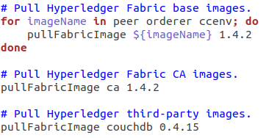
Installing the Development Environment 2/2
cd fabric-dev-servers/fabric-scripts
cp –r hlfv12 hlfv14
Update the downloadFabric.sh in hlfv14 directory
Note: The Hyperledger Fabric base image, CA image, and third-party image version numbers are changed in the downloadFabric.sh file in /fabric-dev-servers/fabric-scripts/hlfv14 as shown in the following figure.
cd ~/fabric-dev-servers
export FABRIC_VERSION=hlfv14
./downloadFabric.sh
For Hyperledger Fabric
V1.4.2
downloadFabric.sh file

Slide 10
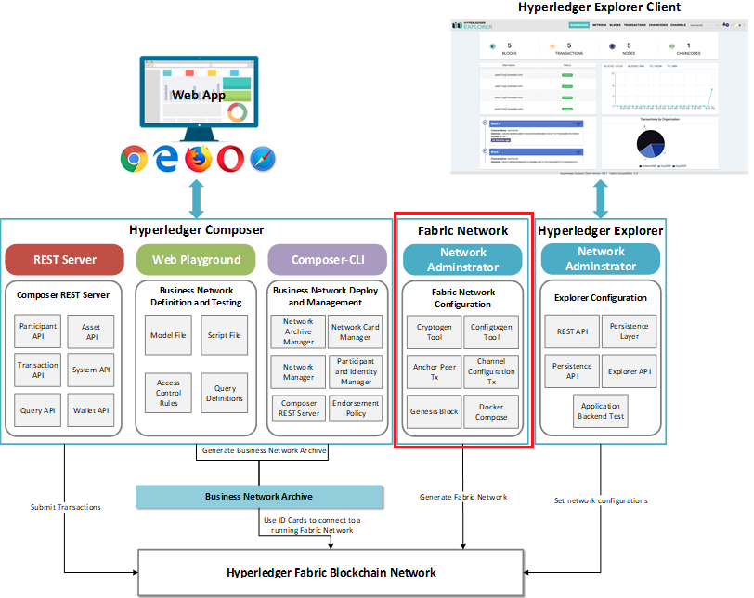
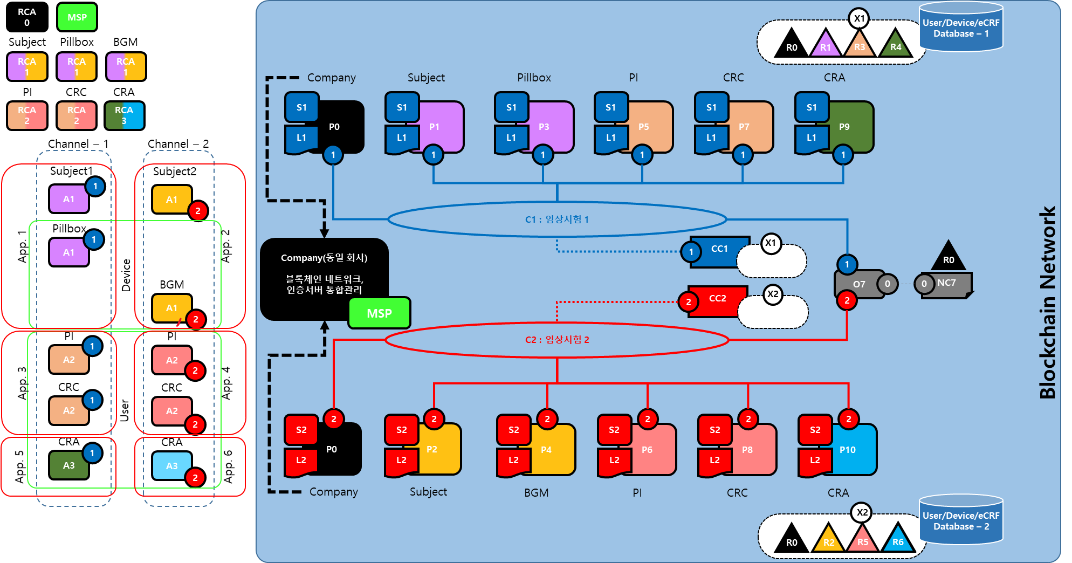
Fabric Network Configuration for Clinical Trial Blockchain – Network Topology
The prototype network is made up of four organizations (Org1, Org2, Org3, Org4) in one channel.
Org1 represents company, Org2 represents home, Org3 represents hospital, Org4 represents CRO.
The organization Org1 uses the domain name org1.example.com. The Membership Services Provider (MSP) for Org1 is called Org1MSP. The rest organizations are defined in the same manner.

Slide 11
Fabric Network Configuration for Clinical Trial Blockchain – Network Components
The Hyperledger Fabric network is made up of several components:
Org 1:
Two peer nodes for Org1, named peer0.org1.example.com (7051) and peer1.org1.example.com (8051)
A single CA for Org1, named ca.org1.example.com (7054)
Two couch db for Org1, named couchdb0 (5984) and couchdb1 (6984)
A single orderer node, named orderer.example.com (7050)
Org 2:
Two peer nodes for Org2, named peer0.org2.example.com (8051) and peer1.org2.example.com (9051)
A single CA for Org2, named ca.org2.example.com (8054)
Two couch db for Org2, named couchdb2 (7984) and couchdb3 (8984)
A single orderer node, named orderer.example.com (7050)
Org 3:
Two peer nodes for Org3, named peer0.org3.example.com (10051) and peer1.org3.example.com (11051)
A single CA for Org3, named ca.org1.example.com (9054)
Two couch db for Org3, named couchdb4 (9984) and couchdb5 (10084)
A single orderer node, named orderer.example.com (7050)
Org 4:
Two peer nodes for Org4, named peer0.org4.example.com (12051) and peer1.org4.example.com (13051)
A single CA for Org4, named ca.org4.example.com (10054)
Two couch db for Org4, named couchdb6 (11084) and couchdb7 (12084)
A single orderer node, named orderer.example.com (7050)
These components are running inside Docker containers. When running Hyperledger Composer within a Docker container, the names above (e.g. peer0.org1.example.com) can be used to interact with the Hyperledger Fabric network.
All of the network components are secured using TLS to encrypt communications. The CA certificates are needed in order to connect to those network components. The CA certificates can be found in the directory containing the byfn.sh script.

Slide 12
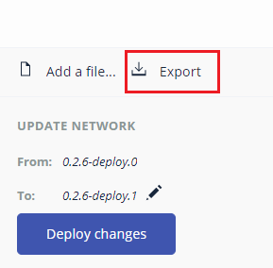
Before Starting
Uncompress the clinical-trial-network.rar file
Copy the clinical-trial-network directory into the fabric root directory (e.g., fabric-dev-servers)
Download the platform binaries, including cryptogen using the following command (three parameters needed):
curl -sSL http://bit.ly/2ysbOFE | bash -s 1.4.2 1.4.2 0.4.15
export COMPOSE_PROJECT_NAME = clinical-trial-network
Modify the peer-base.yaml file in base folder of the clinical-trial-network directory CORE_VM_HOSTCONFIG_NETWORK_MODE=${COMPOSE_PROJECT_NAME}_byfn
Export the clinical-trial-network bna file from the Composer Playground

Slide 13
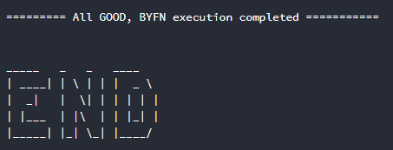
Hyperledger Fabric Network Starting
rm -fr $HOME/.composer
cd fabric-dev-servers/clinical-trial-network
chmod u+x byfn.sh
chmod u+x script/*
./byfn.sh –m generate –o etcdraft
./byfn.sh –m up –s couchdb –a –o etcdraft
The network is started, and verify that you see the following output before proceeding.

Slide 14
Fabric Network Configuration for Clinical Trial Blockchain – Users
The organization Org1 is configured with a user named Admin@org1.example.com. This user is an administrator.
The user Admin@org1.example.com has a set of certificates and private key files stored in the directory: crypto-config/peerOrganizations/org1.example.com/users/Admin@org1.example.com/msp
The organization Org2 is configured with a user named Admin@org2.example.com. This user is an administrator.
The user Admin@org2.example.com has a set of certificates and private key files stored in the directory: crypto-config/peerOrganizations/org2.example.com/users/Admin@org2.example.com/msp
The organization Org3 is configured with a user named Admin@org3.example.com. This user is an administrator.
The user Admin@org3.example.com has a set of certificates and private key files stored in the directory: crypto-config/peerOrganizations/org3.example.com/users/Admin@org3.example.com/msp
The organization Org4 is configured with a user named Admin@org4.example.com. This user is an administrator.
The user Admin@org4.example.com has a set of certificates and private key files stored in the directory: crypto-config/peerOrganizations/org4.example.com/users/Admin@org4.example.com/msp
It is recommended to create a temporary working directory (and subdirectories) to manage the Composer connection profiles and key/certificate files that we will work with later.
mkdir -p /tmp/composer/org1
mkdir -p /tmp/composer/org2
mkdir -p /tmp/composer/org3
mkdir -p /tmp/composer/org4

Slide 15
Fabric Network Configuration for Clinical Trial Blockchain – Locate Certificates for Connection Profiles
Locate required certificates for connection profiles
cd fabric-dev-servers/clinical-trial-network
awk 'NF {sub(/\r/, ""); printf "%s\\n",$0;}' crypto-config/peerOrganizations/org1.example.com/peers/peer0.org1.example.com/tls/ca.crt > /tmp/composer/org1/ca-org1.txt
awk 'NF {sub(/\r/, ""); printf "%s\\n",$0;}' crypto-config/peerOrganizations/org2.example.com/peers/peer0.org2.example.com/tls/ca.crt > /tmp/composer/org2/ca-org2.txt
awk 'NF {sub(/\r/, ""); printf "%s\\n",$0;}' crypto-config/peerOrganizations/org3.example.com/peers/peer0.org3.example.com/tls/ca.crt > /tmp/composer/org3/ca-org3.txt
awk 'NF {sub(/\r/, ""); printf "%s\\n",$0;}' crypto-config/peerOrganizations/org4.example.com/peers/peer0.org4.example.com/tls/ca.crt > /tmp/composer/org4/ca-org4.txt
awk 'NF {sub(/\r/, ""); printf "%s\\n",$0;}' crypto-config/ordererOrganizations/example.com/orderers/orderer.example.com/tls/ca.crt > /tmp/composer/ca-orderer.txt

Slide 16
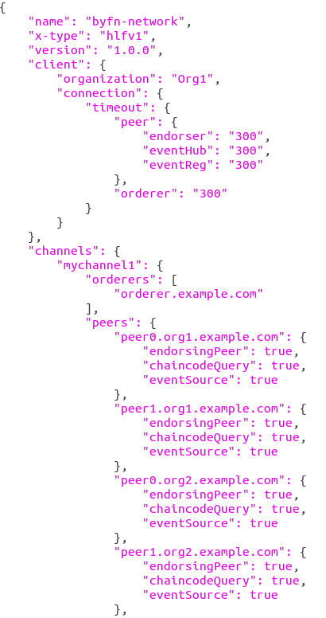
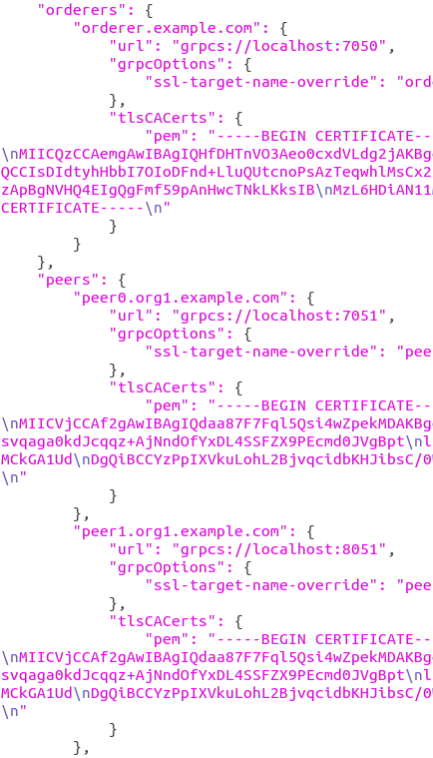
Fabric Network Configuration for Clinical Trial Blockchain – Connection Profiles Configuration
Copy the byfn-network.json file from composer directory to the /tmp/composer.
A channel name mychannel1 has been created. All eight peer nodes have been joined to this channel.
Copy the contents of the file /tmp/composer/org1/ca-org1.txt and replace the text called INSERT_ORG1_CA_CERT.
Copy the contents of the file /tmp/composer/org2/ca-org2.txt and replace the text called INSERT_ORG2_CA_CERT.
Copy the contents of the file /tmp/composer/org3/ca-org3.txt and replace the text called INSERT_ORG3_CA_CERT.
Copy the contents of the file /tmp/composer/org4/ca-org4.txt and replace the text called INSERT_ORG4_CA_CERT.
Copy the contents of the file /tmp/composer/ca-orderer.txt and replace the text INSERT_ORDERER_CA_CERT.
Change the
Specify the organization that admin@org1.example.com belongs to, in a client section with optional timeouts. Once done, save it as a NEW file called /tmp/composer/org1/byfn-network-org1.json.
Customize connection profiles for other organizations.
Sample Connection Profile for Org1

Slide 17
Fabric Network Configuration for Clinical Trial Blockchain – Admin Network Card Configuration
You must first locate the certificate file for this user. The certificate is the public part of the identity. The certificate file can be found in the signcerts subdirectory and is named Admin@org1.example.com-cert.pem, Admin@org2.example.com-cert.pem, Admin@org3.example.com-cert.pem and Admin@org4.example.com-cert.pem.
export ORG1=crypto-config/peerOrganizations/org1.example.com/users/Admin@org1.example.com/msp
cp -p $ORG1/signcerts/A*.pem /tmp/composer/org1
cp -p $ORG1/keystore/*_sk /tmp/composer/org1
export ORG2=crypto-config/peerOrganizations/org2.example.com/users/Admin@org2.example.com/msp
cp -p $ORG2/signcerts/A*.pem /tmp/composer/org2
cp -p $ORG2/keystore/*_sk /tmp/composer/org2
export ORG3=crypto-config/peerOrganizations/org3.example.com/users/Admin@org3.example.com/msp
cp -p $ORG3/signcerts/A*.pem /tmp/composer/org3
cp -p $ORG3/keystore/*_sk /tmp/composer/org3
export ORG4=crypto-config/peerOrganizations/org4.example.com/users/Admin@org4.example.com/msp
cp -p $ORG4/signcerts/A*.pem /tmp/composer/org4
cp -p $ORG4/keystore/*_sk /tmp/composer/org4

Slide 18
Fabric Network Configuration for Clinical Trial Blockchain – Admin Network Card Creation
In this step you will create business network cards for the administrator to use to deploy the blockchain business network to the Hyperledger Fabric network.
Run the composer card create command to create a business network card using the connection profile for each organization. You must specify the path to all three files that you either created or located in the previous steps: (note: the sk file will differ.)
composer card create -p /tmp/composer/org1/byfn-network-org1.json -u PeerAdmin -c /tmp/composer/org1/Admin@org1.example.com-cert.pem -k /tmp/composer/org1/*_sk -r PeerAdmin -r ChannelAdmin -f PeerAdmin@byfn-network-org1.card
composer card create -p /tmp/composer/org2/byfn-network-org2.json -u PeerAdmin -c /tmp/composer/org2/Admin@org2.example.com-cert.pem -k /tmp/composer/org2/*_sk -r PeerAdmin -r ChannelAdmin –f PeerAdmin@byfn-network-org2.card
composer card create -p /tmp/composer/org3/byfn-network-org3.json -u PeerAdmin -c /tmp/composer/org3/Admin@org3.example.com-cert.pem -k /tmp/composer/org3/*_sk -r PeerAdmin -r ChannelAdmin –f PeerAdmin@byfn-network-org3.card
composer card create -p /tmp/composer/org4/byfn-network-org4.json -u PeerAdmin -c /tmp/composer/org4/Admin@org4.example.com-cert.pem -k /tmp/composer/org4/*_sk -r PeerAdmin -r ChannelAdmin -f PeerAdmin@byfn-network-org4.card
If the command works successfully, a business network card file called PeerAdmin@byfn-network-org1.card , PeerAdmin@byfn-network-org2.card , PeerAdmin@byfn-network-org3.card and PeerAdmin@byfn-network-org4.card will have been written to the current directory.

Slide 19
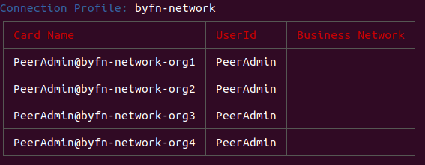
Fabric Network Configuration for Clinical Trial Blockchain – Admin Network Card Importing
Run the composer card import command to import the business network card for Org1 into the wallet:
composer card import -f PeerAdmin@byfn-network-org1.card --card PeerAdmin@byfn-network-org1
composer card import -f PeerAdmin@byfn-network-org2.card --card PeerAdmin@byfn-network-org2
composer card import -f PeerAdmin@byfn-network-org3.card --card PeerAdmin@byfn-network-org3
composer card import -f PeerAdmin@byfn-network-org4.card --card PeerAdmin@byfn-network-org4
If the command works successfully, a business network card called PeerAdmin@byfn-network-org1 , PeerAdmin@byfn-network-org2, PeerAdmin@byfn-network-org3, PeerAdmin@byfn-network-org4 will have been imported into the wallet.
Using the following command to check the imported business network cards in wallet:
composer card list
Snapshot of Composer Card Wallet

Slide 20
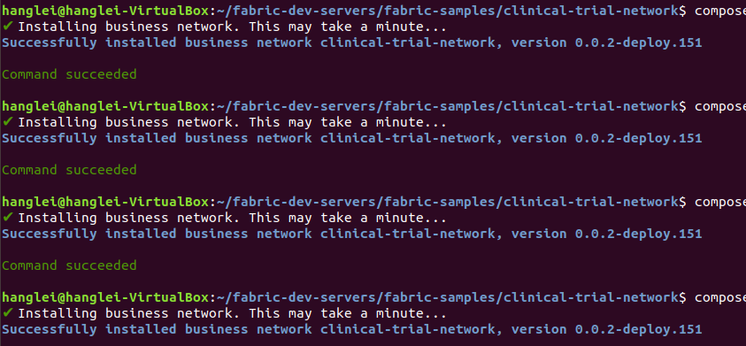
Fabric Network Configuration for Clinical Trial Blockchain – Business Network Installation
Run the composer network install command to install the business network onto all of the Hyperledger Fabric peer nodes for each organization that you specified in the connection profile file you created:
composer network install --card PeerAdmin@byfn-network-org1 --archiveFile clinical-trial-network.bna
composer network install --card PeerAdmin@byfn-network-org2 --archiveFile clinical-trial-network.bna
composer network install --card PeerAdmin@byfn-network-org3 --archiveFile clinical-trial-network.bna
composer network install --card PeerAdmin@byfn-network-org4 --archiveFile clinical-trial-network.bna
A useful feature of the network install command is that it will output the name of the business network and the version number that has just been installed and you can note these down for use later.
Snapshot of Business Network Installation

Slide 21
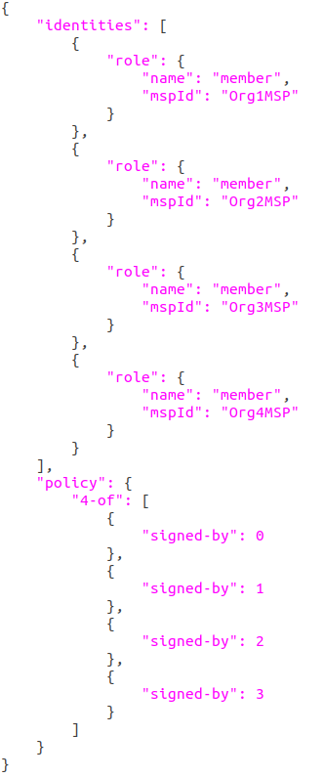
Fabric Network Configuration for Clinical Trial Blockchain – Endorsement Policy Definition
Create an endorsement policy file called /tmp/composer/endorsement-policy.json with the following contents and save it to disk.
The endorsement policy you have just created states that all four organizations must endorse transactions in the business network before they can be committed to the blockchain. If any of them dose not endorse transactions, or disagree on the result of a transaction, then the transaction will be rejected by the business network.
Endorsement Err: error trying invoke business network with transaction with code endorsement policy failure : signature set did not satisfy policy (further confirmation required).
Endorsement Policy.json

Slide 22
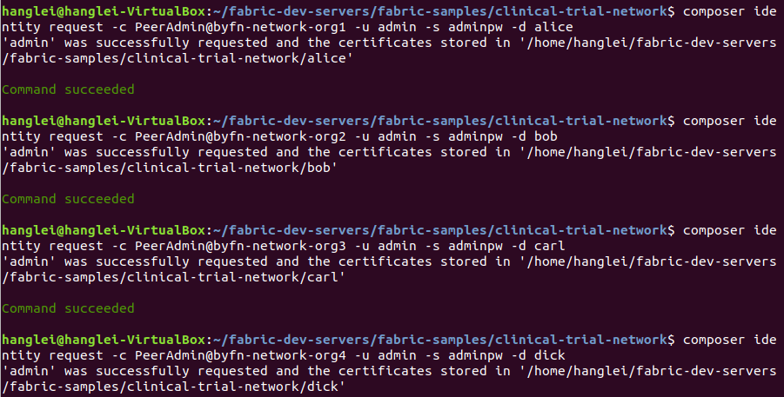
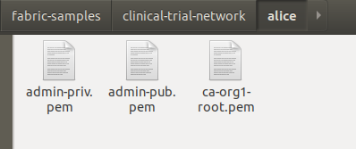
Fabric Network Configuration for Clinical Trial Blockchain – Retrieve Business Network Admin Certificates
Run the composer identity request command to retrieve certificates for alice, bob, carl and dick to use as the business network administrator for each organization:
composer identity request -c PeerAdmin@byfn-network-org1 -u admin -s adminpw -d alice
composer identity request -c PeerAdmin@byfn-network-org2 -u admin -s adminpw -d bob
composer identity request -c PeerAdmin@byfn-network-org3 -u admin -s adminpw -d carl
composer identity request -c PeerAdmin@byfn-network-org4 -u admin -s adminpw -d dick
The -u admin and the -s adminpw options to this command correspond to the default user registered with the Hyperledger Fabric CA (Certificate Authority). The certficates will be placed into a directory in the current working directory. There are three certificate files created, but only two are important. These are admin-pub.pem, the certificate (including the public key), and admin-priv.pem, the private key. Only the admin-pub.pem file is suitable for sharing with other organizations. The admin-priv.pem file must be kept secret as it can be used to sign transactions on behalf of the issuing organization.
Retrieved Certificates for Alice

Slide 23
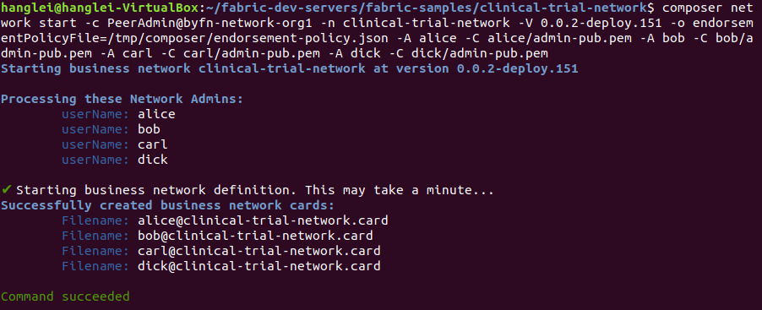
Fabric Network Configuration for Clinical Trial Blockchain – Start the Business Network
Run the composer network start command to start the business network. Only Org1 needs to perform this operation. This command uses the /tmp/composer/endorsement-policy.json file, and the admin-pub.pem files created by all of four admins, so you must ensure that all of these files are accessible to this command:
composer network start -c PeerAdmin@byfn-network-org1 -n clinical-trial-network -V 0.0.2-deploy.151 -o endorsementPolicyFile=/tmp/composer/endorsement-policy.json -A alice -C alice/admin-pub.pem -A bob -C bob/admin-pub.pem -A carl -C carl/admin-pub.pem -A dick -C dick/admin-pub.pem
set the network to use the default endorsement policy without –o option
Snapshot of Start the Business Network

Slide 24
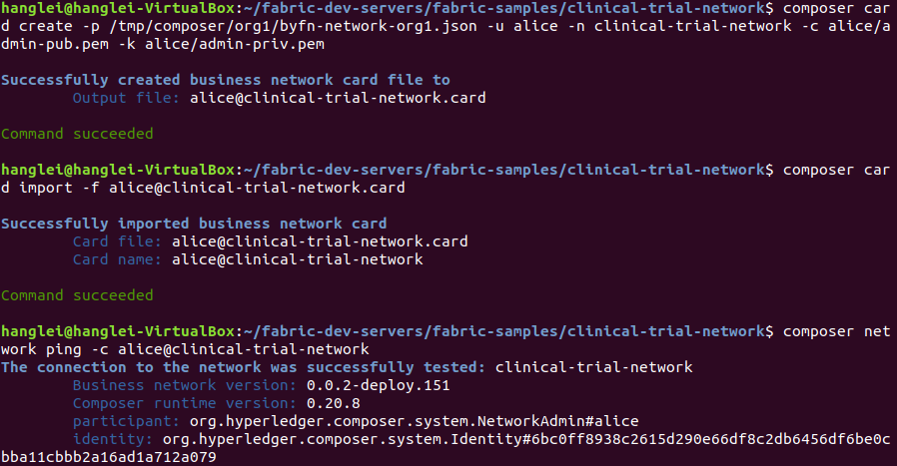
Fabric Network Configuration for Clinical Trial Blockchain – Create Business Network Card to Access the Business Network as Org1
Run the composer card create command to create a business network card that Alice, the business network administrator for Org1, can use to access the business network:
composer card create -p /tmp/composer/org1/byfn-network-org1.json -u alice -n clinical-trial-network -c alice/admin-pub.pem -k alice/admin-priv.pem
Run the composer card import command to import the business network card that you just created:
composer card import -f alice@clinical-trial-network.card
Run the composer network ping command to test the connection to the blockchain business network:
composer network ping -c alice@clinical-trial-network
Snapshot of Connect to the Business Network as Org1

Slide 25
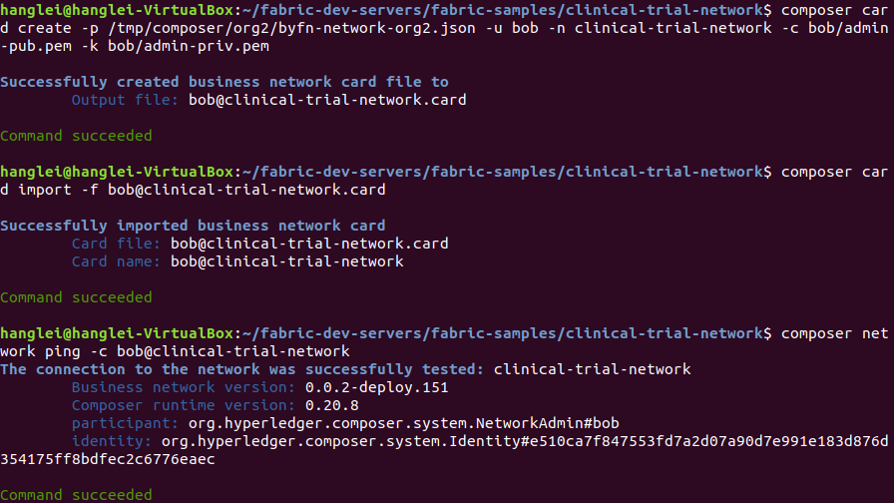
Fabric Network Configuration for Clinical Trial Blockchain – Create Business Network Card to Access the Business Network as Org2
Run the composer card create command to create a business network card that Bob, the business network administrator for Org2, can use to access the business network:
composer card create -p /tmp/composer/org2/byfn-network-org2.json -u bob -n clinical-trial-network -c bob/admin-pub.pem -k bob/admin-priv.pem
Run the composer card import command to import the business network card that you just created:
composer card import -f bob@clinical-trial-network.card
Run the composer network ping command to test the connection to the blockchain business network:
composer network ping -c bob@clinical-trial-network
Snapshot of Connect to the Business Network as Org2

Slide 26
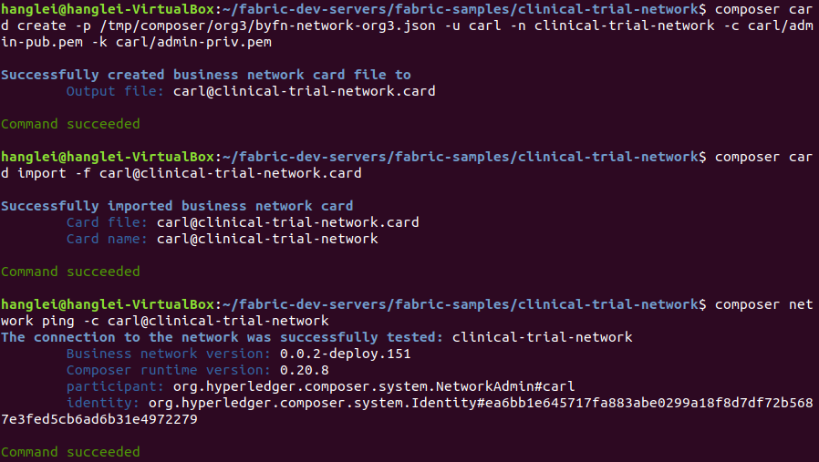
Fabric Network Configuration for Clinical Trial Blockchain – Create Business Network Card to Access the Business Network as Org3
Run the composer card create command to create a business network card that Carl, the business network administrator for Org3, can use to access the business network:
composer card create -p /tmp/composer/org3/byfn-network-org3.json -u carl -n clinical-trial-network -c carl/admin-pub.pem -k carl/admin-priv.pem
Run the composer card import command to import the business network card that you just created:
composer card import -f carl@clinical-trial-network.card
Run the composer network ping command to test the connection to the blockchain business network:
composer network ping -c carl@clinical-trial-network
Snapshot of Connect to the Business Network as Org3

Slide 27
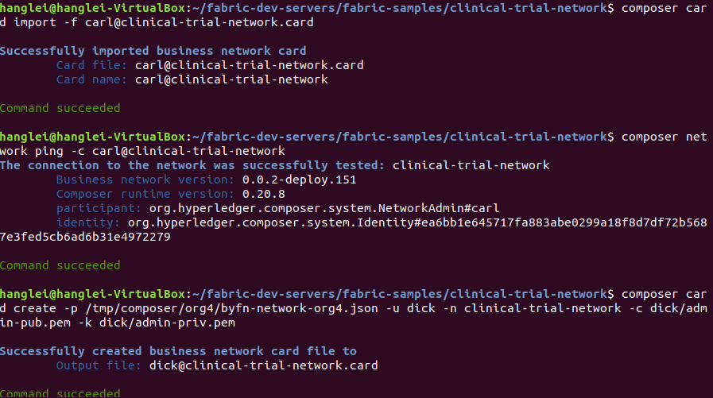
Fabric Network Configuration for Clinical Trial Blockchain – Create Business Network Card to Access the Business Network as Org4
Run the composer card create command to create a business network card that Dick, the business network administrator for Org4, can use to access the business network:
composer card create -p /tmp/composer/org4/byfn-network-org4.json -u dick -n clinical-trial-network -c dick/admin-pub.pem -k dick/admin-priv.pem
Run the composer card import command to import the business network card that you just created:
composer card import -f dick@clinical-trial-network.card
Run the composer network ping command to test the connection to the blockchain business network:
composer network ping -c dick@clinical-trial-network
Snapshot of Connect to the Business Network as Org4

Slide 28
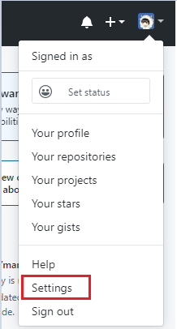
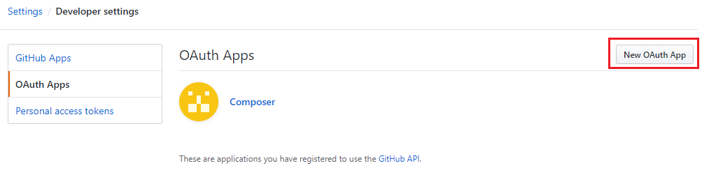
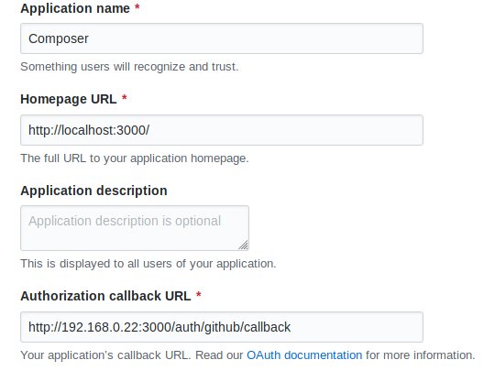
Fabric Network Configuration for Clinical Trial Blockchain - Enable authentication for the REST server
Install the passport-github strategy to authenticate users using GitHub ID.
npm install -g passport-github
Configure the REST server to use an authentication strategy
Navigate to GitHub and log in with your user ID and password.
Click the dropdown menu besides the head portrait in the top right corner. Click Settings.
Navigate to developer settings and register a new OAuth application.
Specify the application settings.
Application name: Composer
Homepage: http://localhost:3000/
Application description: OAuth application for Composer
Authorization callback URL: http://localhost:3000/auth/github/callback

Slide 29
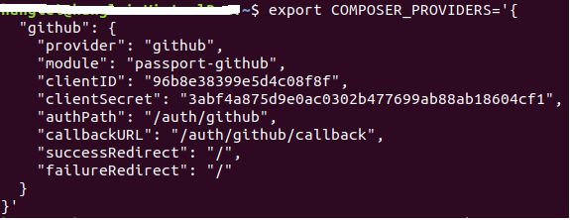
Fabric Network Configuration for Clinical Trial Blockchain - Enable authentication for the REST server
Set the configuration of REST server using the environment variable COMPOSER_PROVIDERS.
export COMPOSER_PROVIDERS='{
"github": {
"provider": "github",
"module": "passport-github",
"clientID": "REPLACE_WITH_CLIENT_ID",
"clientSecret": "REPLACE_WITH_CLIENT_SECRET",
"authPath": "/auth/github",
"callbackURL": "/auth/github/callback",
"successRedirect": "/",
"failureRedirect": "/"
}
}'
Snapshot of REST Server Environment Variable in Command Line

Slide 30
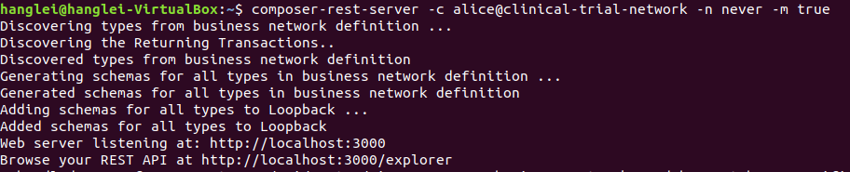
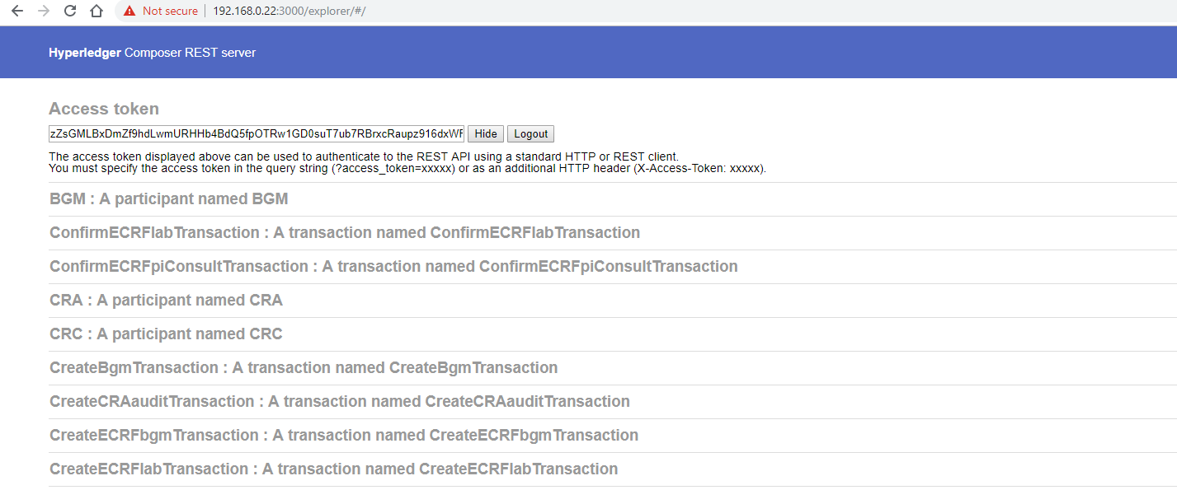
Fabric Network Configuration for Clinical Trial Blockchain – Start Fabric REST Server
Starting the REST server with REST API authentication and multiple user node enabled (as the admin of Org1)
composer-rest-server -c alice@clinical-trial-network -a true -m true -n never
http://localhost:3000
Authenticate to the REST server by navigating to the value of the authPath property specified in the environment variable COMPOSER_PROVIDERS.
http://localhost:3000/auth/github

Slide 31
Hyperledger Explorer Configuration for Clinical Trial Blockchain - Dependencies
Nodejs 8.11.x (Note that v9.x is not yet supported)
PostgreSQL 9.5 or greater
jq
Linux-based operating system, such as Ubuntu or MacOS
Docker CE 18.09.2 or later
Docker Compose 1.14.0

Slide 32
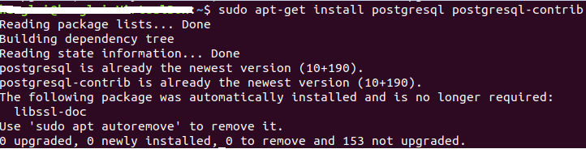
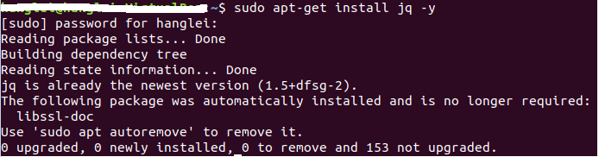
Hyperledger Explorer Configuration for Clinical Trial Blockchain - Dependencies Installation
sudo apt-get update
sudo apt-get install postgresql postgresql-contrib
sudo apt-get install jq -y

Slide 33
Hyperledger Explorer Configuration for Clinical Trial Blockchain - Clone GIT Repository
git clone https://github.com/hyperledger/blockchain-explorer.git
cd blockchain-explorer

Slide 34
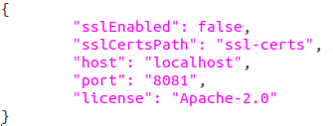
Hyperledger Explorer Configuration for Clinical Trial Blockchain - Explorer App Config Setup
cd blockchain-explorer
Modify appconfig.json to update explorer app settings
host: the port for the explorer browser
Config settings in appconfig.json

Slide 35
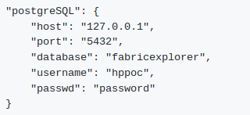
Hyperledger Explorer Configuration for Clinical Trial Blockchain - Database Setup
cd blockchain-explorer/app
Modify explorerconfig.json to update PostgreSQL database settings
Run create database script:
cd blockchain-explorer/app/persistence/fabric/postgreSQL/db
sudo –u postgres ./createdb.sh
Database settings in explorerconfig.json

Slide 36
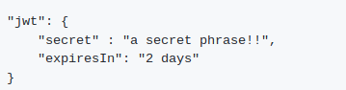
Hyperledger Explorer Configuration for Clinical Trial Blockchain - Authorization Configuration
cd blockchain-explorer/app
Modify explorerconfig.json to update Authorization (JWT) settings
jwt:
secret: secret string to sign the payload
expireIn: expressed in seconds or a string describing a time span (e.g., 60, “2 days”, “10h”, “7d”)
Authorization settings in explorerconfig.json

Slide 37
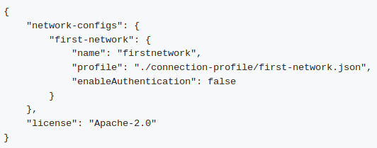
Hyperledger Explorer Configuration for Clinical Trial Blockchain - Configure Hyperledger Fabric 1/2
cd blockchain-explorer/app/platform/fabric
Modify config.json to define the fabric network connection profile
“first-network” is the name of the connection file, and can be changed to any name
“name” is a name you want to give to your fabric network
“profile” is the location of the connection file
Connection profiles settings in config.json

Slide 38
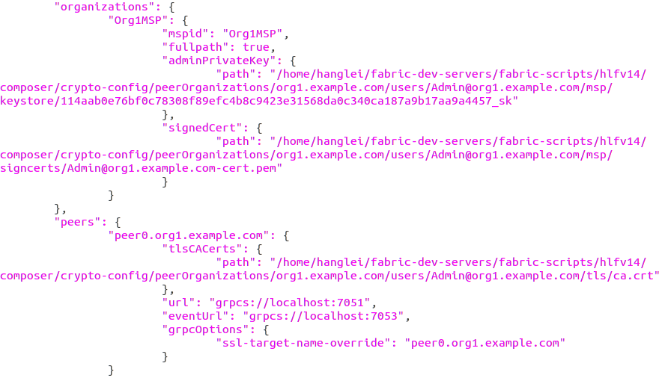
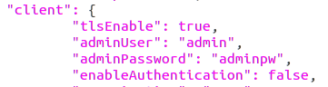
Hyperledger Explorer Configuration for Clinical Trial Blockchain - Configure Hyperledger Fabric 2/2
Modify connection profile in the JSON file first-network.json
Provide the full disk path to the adminPrivateKey, signedCert, and tlsCACerts config options
“adminUser” is the admin user of the network, “adminPassword” is the password for the admin user, “enableAuthentication” is a flag to enable authentication using a login page
Connection profiles settings in config.json

Slide 39
Hyperledger Explorer Configuration for Clinical Trial Blockchain - Build Hyperledger Explorer
On another terminal:
./main.sh install (to install, run tests, and build project)
./main.sh clean (clean all the files generated in the installation stage)
Or
cd blockchain-explorer
npm install
cd blockchain-explorer/app/test
npm install
cd blockchain-explorer/client
npm install
npm test -- -u --coverage
npm run build

Slide 40
Hyperledger Explorer Configuration for Clinical Trial Blockchain - Run Hyperledger Explorer
cd blockchain-explorer
./start.sh (it will have the backend up)
./start.sh debug (it will have the backend in debug mode)
./start.sh print (it will print help)
Launch the URL http(s)://localhost:8081 on a browser
./stop.sh (it will stop the node server)

Slide 41
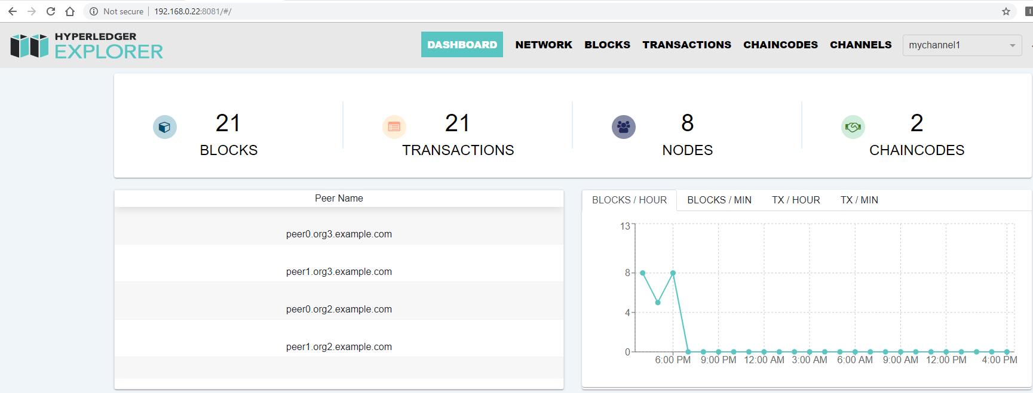
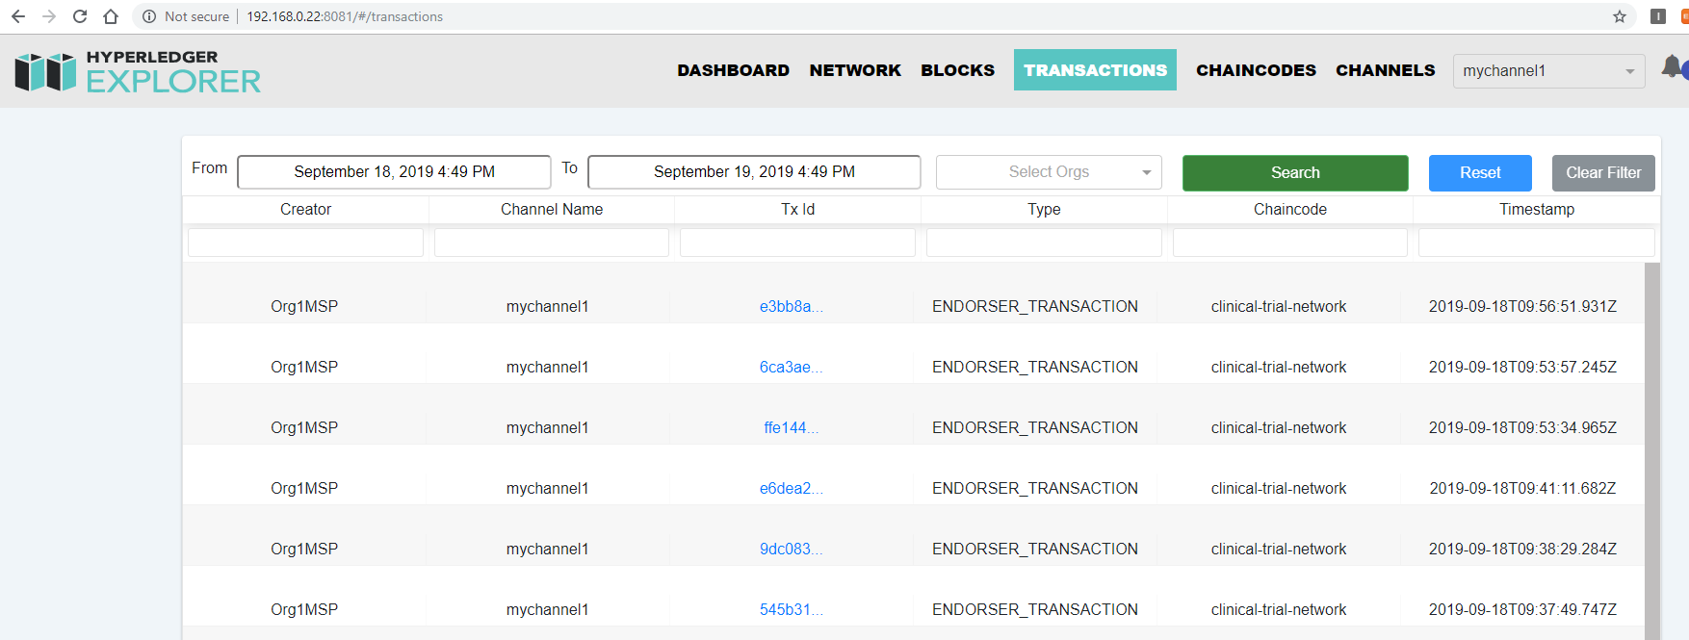
Hyperledger Explorer Configuration for Clinical Trial Blockchain - Testing
http://localhost:8081

Slide 42
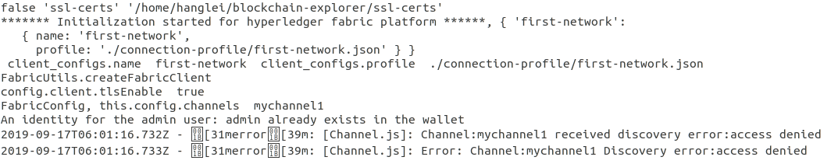
Hyperledger Explorer Configuration for Clinical Trial Blockchain - Troubleshoot
Problem Description: Received discovery error, access denied error
Background Information:
Possible Cause: The “wallet” crypto is incorrect, or outdated
Possible Solution: Delete directory “wallet” located in blockchain-explorer directory, and restart explorer $./start.sh
Related Information: HL Explorer support for HL Fabric 1.4

Slide 43
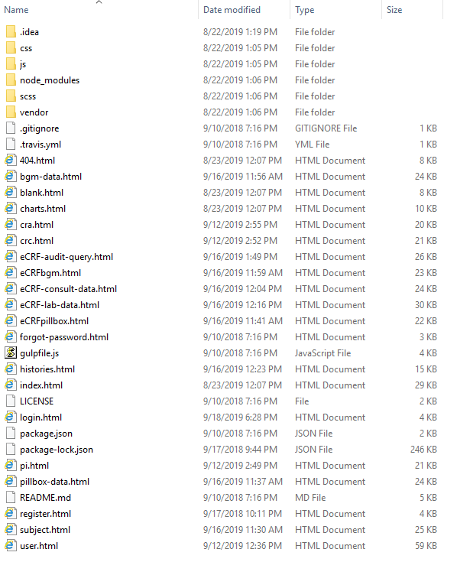
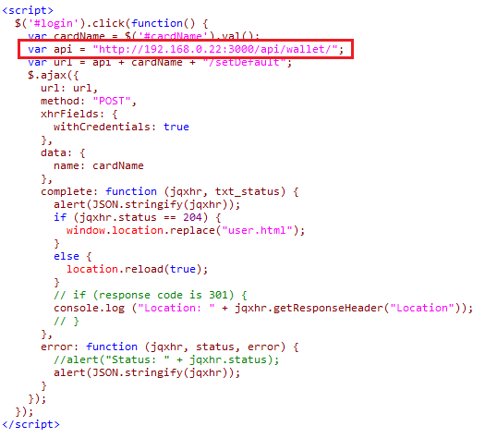
Clinical Trial Blockchain Testing and Results - Client App Configuration
The client app contains various html files and libraries.
You need to modify the request APIs in each HTML file.
Set the IP address of the API by using the address of your virtual machine.
Use the address of your virtual machine
Request in login.html
Client app structure

Slide 44
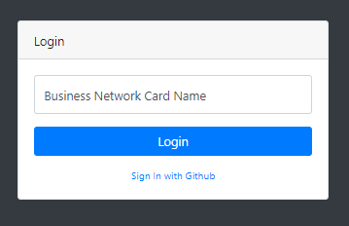
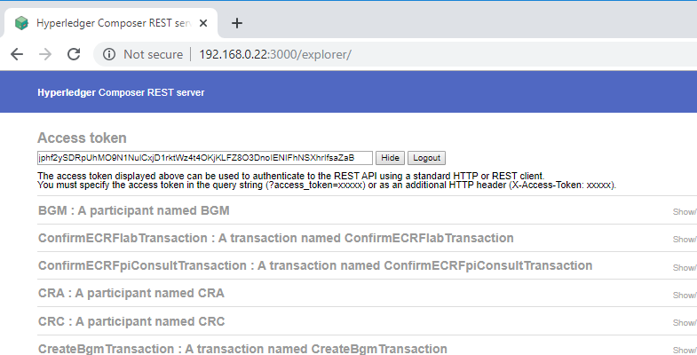
Clinical Trial Blockchain Testing and Results - Access Token Generation
Open the login.html with the web browser (e.g. Chrome).
Click “Sign in with Github” to generate the access token from Github OAuth2.0 provider.
The generated access token is displayed in the REST server browser.

Slide 45
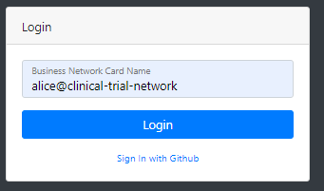
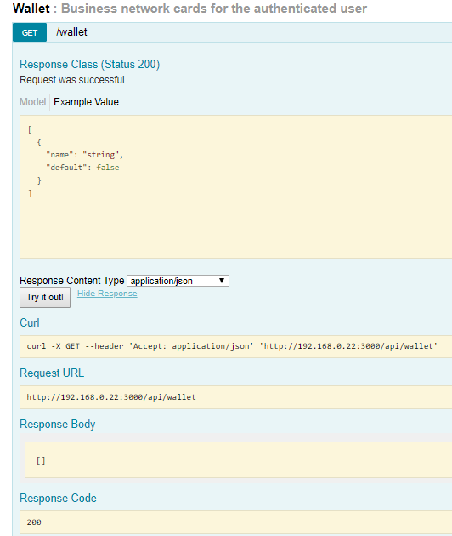
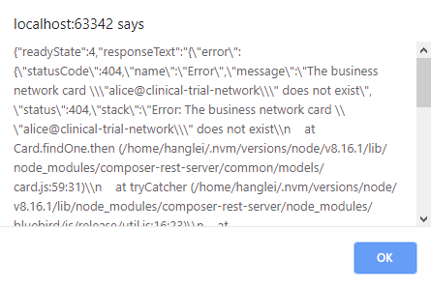
Clinical Trial Blockchain Testing and Results - User Login Configuration (1/3)
Open the login .html with the web browser (e.g. Chrome).
Type the business network card (e.g. alice@clinical-trial-network) and click “Login”. In this case it shows the err that the business network card dose not exist.
Expand the Wallet API in REST server browser and click “GET” to get all of the business network cards in the wallet. In default, the wallet is empty.
The generated access token is displayed in the REST server browser.
As a result, we need to import the business network card before login in using the web app.

Slide 46
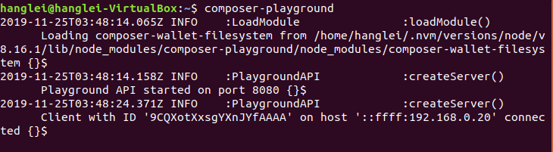
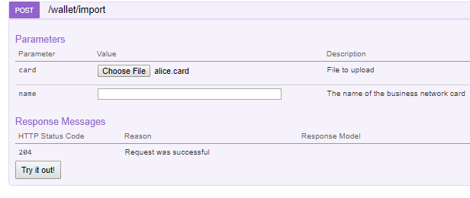
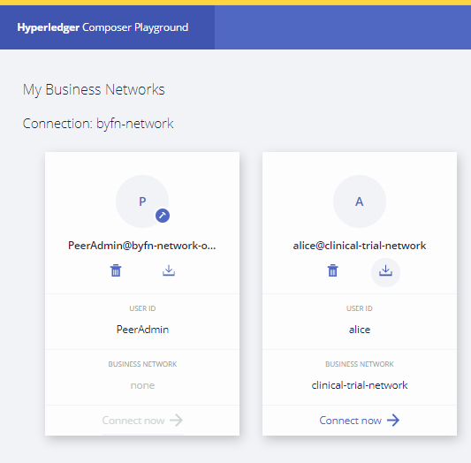
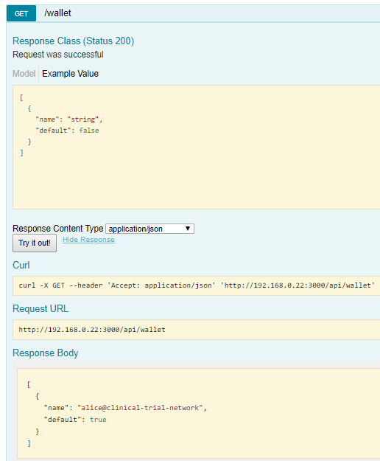
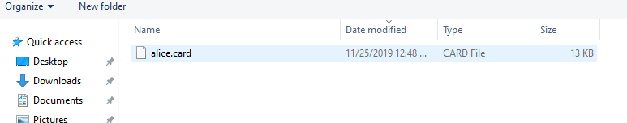
Clinical Trial Blockchain Testing and Results - User Login Configuration (2/3)
To get the business network for of alice, we can open the Composer Playground by inputting the following command in the terminal.
composer-playground
Export the business network card in Composer Playground and store in the local system.
Import the business network card by using the /wallet/import API in REST server browser.
Click “GET” to check whether the business network is imported. Now alice is ready to login.

Slide 47
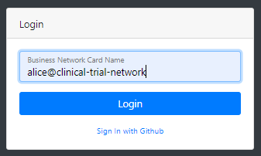

Clinical Trial Blockchain Testing and Results - User Login Configuration (3/3)
Open the login .html with the web browser (e.g. Chrome).
Type the business network card (e.g. alice@clinical-trial-network) and click “Login”. This time, the login process is succeeded and the browser navigates to the main interface of the web app.

Slide 48


Clinical Trial Blockchain Testing and Results - User Login
Open the login.html with the web browser (e.g., Chrome).
Business network cards are issued by the Fabric CA for authenticated users who can access the resources in the blockchain.
The user inputs the name of the business network card in order to connect with the blockchain network.
Login.html

Slide 49

Clinical Trial Blockchain Testing and Results - User Profile Management
The admin can manage user profiles. For example, the admin can create or delete the user profile.
Admin view

Slide 50




Clinical Trial Blockchain Testing and Results - User Identity Management
The admin can manage the identities for participants. The admin can issue or revoke the identity for a specified user.
The issued identity is a credential file which is stored in the local storage.
Admin view

Slide 51



Clinical Trial Blockchain Testing and Results - Wallet Management
The admin can manage the wallet which holds the identity card for every user. The admin can import or delete the identity card in the wallet. Wallet dashboard represents the identity info that is enrolled in the blockchain network. The default value represents the current identity that can interact with the blockchain network.
Admin view

Slide 52

Clinical Trial Blockchain Testing and Results - Subject Profile Management
PI and CRC can manage subject profiles. For example, they can create, update and delete the subject.
CRA can view the subject profiles
PI/CRC/CRA View

Slide 53


Clinical Trial Blockchain Testing and Results - Pillbox Data Management
PI and CRC can manage device pillbox profiles. For example, they can create, update and delete the pillbox.
The pillbox can only access and view its own data profile.
PI/CRC View
Pillbox View

Slide 54


Clinical Trial Blockchain Testing and Results - eCRF Pillbox Data Management
Pillbox can generate eCRF pillbox data.
PI/CRC can view the generated eCRF pillbox data.
PI/CRC View

Slide 55


Clinical Trial Blockchain Testing and Results - BGM Data Management
PI and CRC can manage device BGM profiles. For example, they can create, update and delete the BGM.
The BGM can only access and view its own data profile.
PI/CRC View
BGM View

Slide 56


Clinical Trial Blockchain Testing and Results - eCRF BGM Data Management
BGM can generate eCRF bgm data.
PI/CRC can view the generated eCRF bgm data.
PI/CRC View

Slide 57


Clinical Trial Blockchain Testing and Results - eCRF PI Consult Data Management
Both PI and CRC can create and update the eCRF PI consult data. There is a data lock filed that presents whether the consult data is locked.
CRA can view the eCRF PI consult data.
The consult data created by the CRC needed to be confirmed by the PI.
However the consult data created by the PI is confirmed the same time as it is created.
After confirmation, the data lock filed is set to true which means the consult data is locked and can not be edited.
PI/CRC/CRA View
PI View

Slide 58


Clinical Trial Blockchain Testing and Results - eCRF LAB Data Management
Both PI and CRC can create and update the eCRF LAB test data. There is a data lock filed that presents whether the LAB data is locked.
CRA can view the eCRF LAB data.
The LAB data created by the CRC needed to be confirmed by the PI.
However the LAB data created by the PI is the confirmed the same time as it is created.
After confirmation, the data lock filed is set to true which means the consult data is locked and can not be edited.
PI/CRC/CRA View
PI View

Slide 59


Clinical Trial Blockchain Testing and Results - eCRF CRA Audit Query
CRA can create the audit query data and there are two kinds of audit: PI consult data or LAB test data.
When the audit query is created, it will inform the specified PI/CRC by updating the data flag field (PI Consult Flag or LAB Data Flag).
The PI/CRC then update the PI consult data or LAB test data according to the act note.
The PI/CRC can update the audit query after they complete the revision requested by the CRA.
PI/CRC/CRA View
PI View

Slide 60
감사합니다.

